Slide 1

The Impact of Calcified Nodules on 2-year Clinical Outcomes:
Patient-Level Pooled Analysis from the Disrupt CAD III and IV OCT Sub-studies
Richard A. Shlofmitz, MD
Chairman of Cardiology
St. Francis Hospital
Roslyn, NY
Shigeru Saito, MD; Robert F. Riley, MD; Jonathan M. Hill, MD; Ziad A. Ali, MD DPhil; Akiko Maehara, MD; Gregg W. Stone, MD; Dean J. Kereiakes, MD

Slide 2
<First Name> <Last Name>, <Degree(s)>
I have no relevant financial relationships
OR
<Type of Relationship>:
<Company 1>
<Company 2>
<Type of Relationship>:
<Company 1>
<Company 2>
Examples of relationships are: Advisory Board/Board Member, Consultant, Honoraria,
Research Support, Speaker’s Bureau, Stockholder
Please list full company name

Slide 3

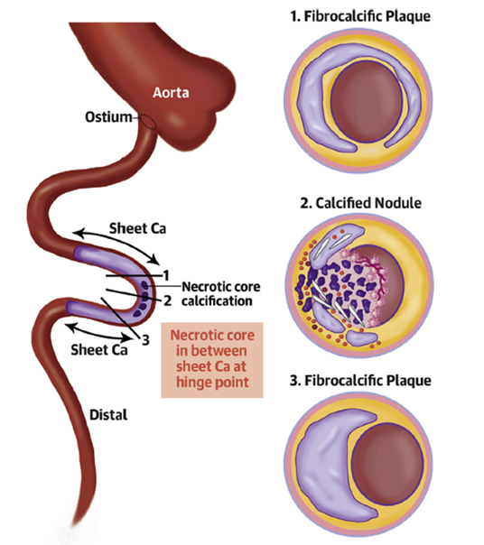
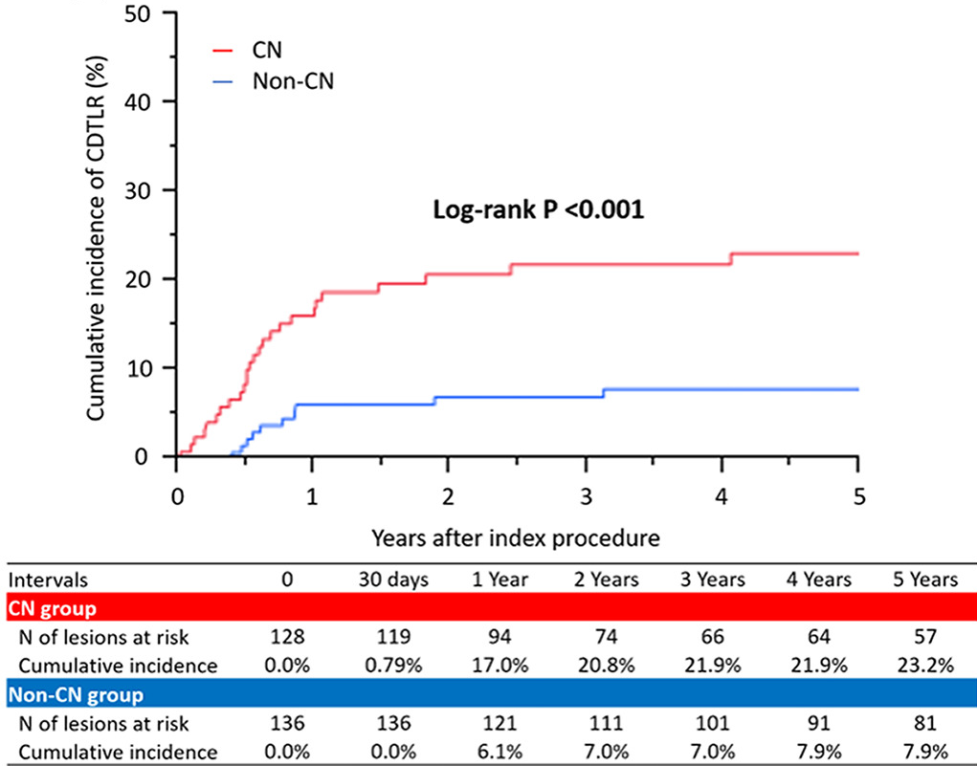
Calcific Nodules
Often occur at sites of increased torsional stress and flanked by collagen-rich calcium
Associated with stent under-expansion and worse long-term outcomes following PCI
3x event rate in CN
Torii, S. et al. J Am Coll Cardiol. 2021;77(13):1599-611; Morofuji T, et al. Catheter Cardiovasc Interv. 2021 Jan 1;97(1):10-19.

Slide 4



Pooled Analysis Study Design
CAD III OCT sub-study
N = 94
CAD IV OCT Sub-study
N = 61
Objective: To evaluate the impact of IVL treatment of calcified nodules (CN) on 2-year clinical outcomes
Population: Patient-level pooled analysis of the Disrupt CAD III-IV OCT sub-studies
  Uniform study criteria, endpoints, adjudication, follow-up
Endpoints: CEC-adjudicated target lesion failure (TLF) and stent thrombosis (definite or probable) at 2-years
ITT Population
N = 155
21 global sites in 3 countries
CN group
2-year follow-up
n = 29
Non-CN group
2-year follow-up
n = 126

Slide 5
Baseline Patient Characteristics
Characteristic | Patients without CN N=126 | Patients with CN N=29 | P value
Age | 73.4 ± 9.0 | 71.9 ± 8.8 | 0.40
Male | 76.2% | 96.6% | 0.01
Hypertension | 84.9% | 82.8% | 0.77
Hyperlipidemia | 86.5% | 89.7% | 0.65
Diabetes mellitus | 39.7% | 48.3% | 0.40
Current or former smoker | 59.5% | 62.1% | 0.97
Prior MI | 16.7% | 31.0% | 0.08
Prior Stroke or TIA | 13.5% | 13.8% | 0.97
Renal insufficiency* | 1.6% | 17.2% | <0.01
*Defined as eGFR <60ml/min/1.73m²; eGFR=estimated glomerular filtration rate using the MDRD formula

Slide 6
Baseline Angiographic Characteristics
Core lab assessment | Patients without CN N=126 | Patients with CN N=29 | P value
Lesion location |  |  | <.01
LAD | 79.4% | 27.6%
RCA | 16.7% | 55.2%
Circumflex | 4.0% | 13.8%
Left Main | 0.0% | 3.4%
RVD, mm | 3.0 ± 0.4 | 3.1 ± 0.4 | 0.22
MLD, mm | 1.1 ± 0.3 | 1.1 ± 0.4 | 0.57
Diameter stenosis, % | 62.9 ± 10.0 | 65.9 ±12.2 | 0.18
Lesion length, mm | 27.8 ± 11.1 | 28.3 ± 10.8 | 0.82
Calcified length, mm | 49.9 ±18.8 | 57.7 ± 17.0 | 0.04
Severe calcification | 100.0% | 100.0% | -
Bifurcation lesion | 31.0% | 13.8% | 0.06

Slide 7
Procedural Characteristics
Characteristic | Patients without CN N=126 | Patients with CN N=29 | P value
Procedure time | 57.3 ± 22.4 | 71.0 ± 26.1 | <0.01
Contrast volume | 197.0 ± 66.5 | 179.7 ± 51.8 | 0.19
Pre-dilatation | 25.4% | 51.7% | <0.01
Number of pulses | 87.9 ± 44.1 | 93.0 ± 44.2 | 0.57
Post-IVL dilatation | 11.9 | 13.8 | 0.78
Number of stents implanted | 1.3 ± 0.5 | 1.3 ± 0.5 | 0.95
Total stent length | 34.8 ± 12.3 | 34.7 ± 12.9 | 0.96
Post-stent dilatation | 100% | 100% | -
No Dissection (D-F), perforation, abrupt closure, slow/no-flow in either group

Slide 8
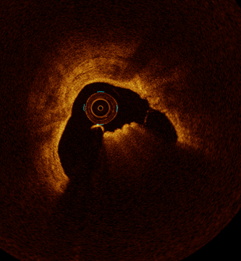
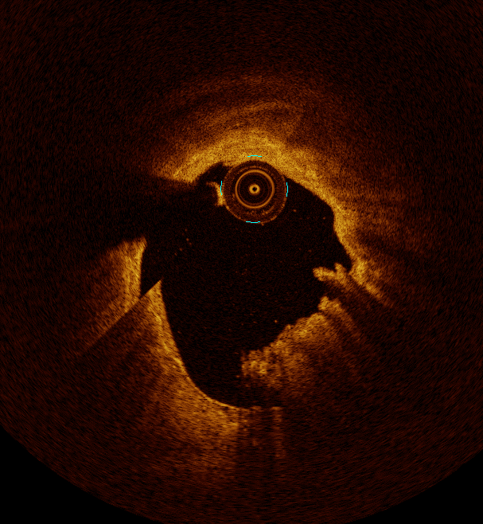
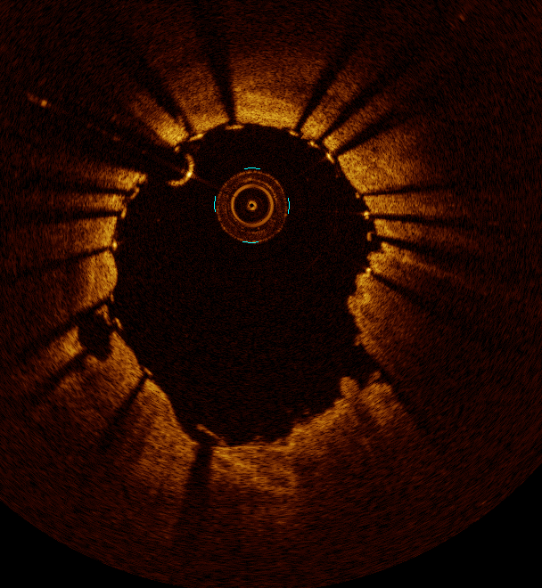
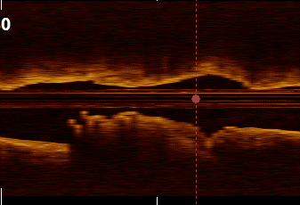
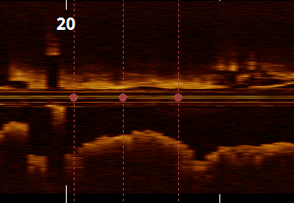
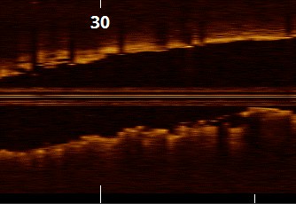
Deformed Eruptive Nodule
Pre-IVL
Post-IVL
Post-Stent
A
A’
A’’
34%

Slide 9

Eruptive CN: Deformable
Post-IVL
Post-stent

Slide 10
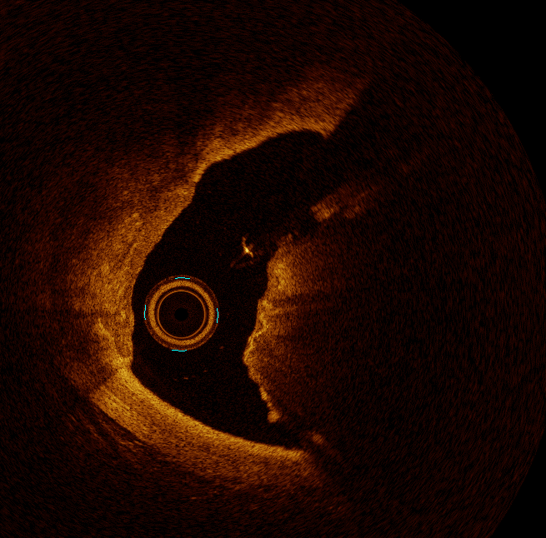
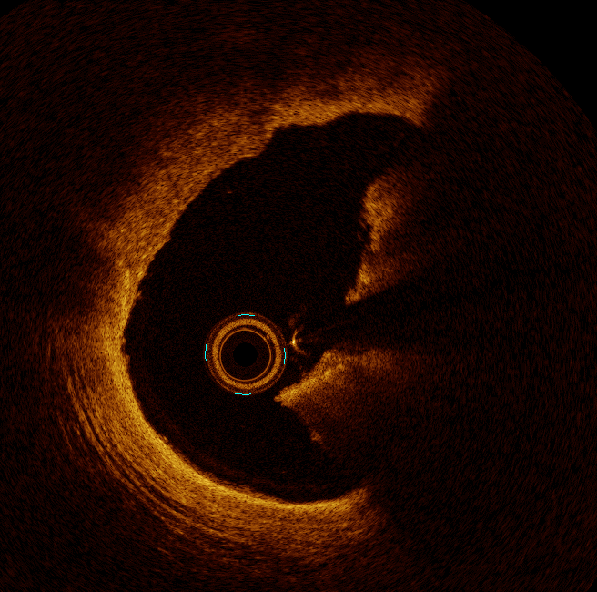
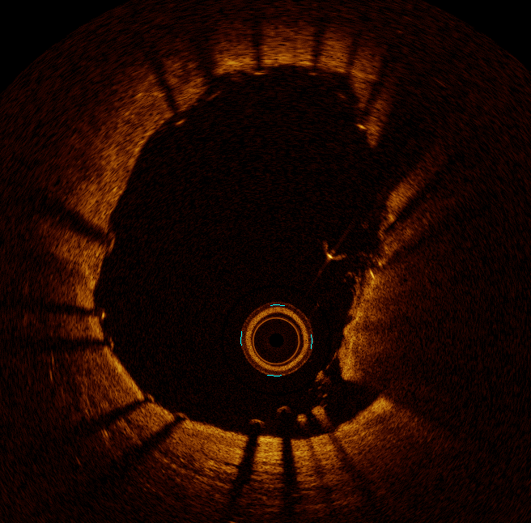
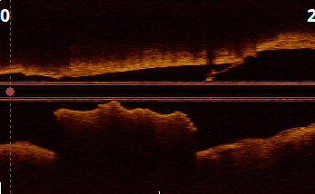
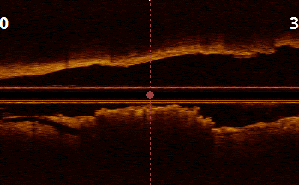
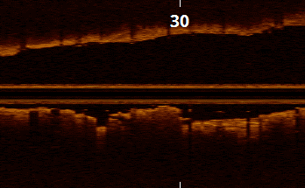
Deformed Protruding Nodule
Pre-IVL
Post-IVL
Post-Stent
B
B’
B’’
77%

Slide 11
Deformed Protruding Nodule

Slide 12
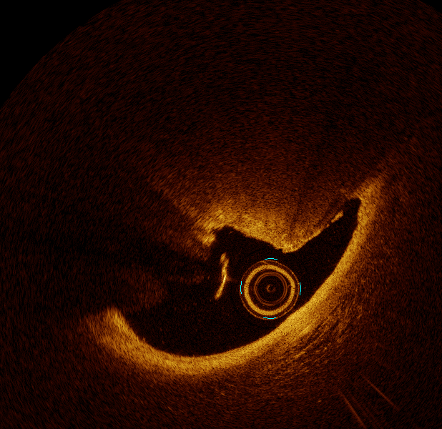
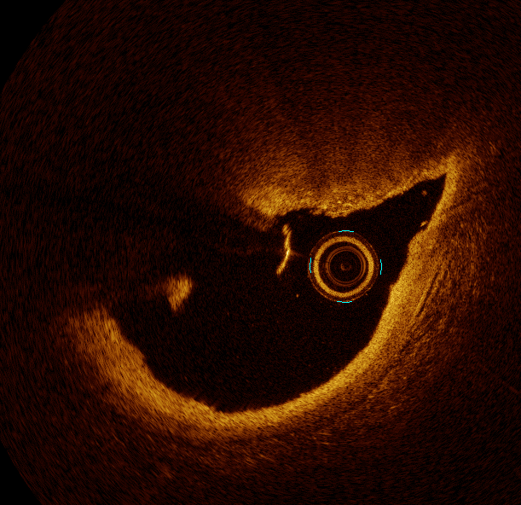
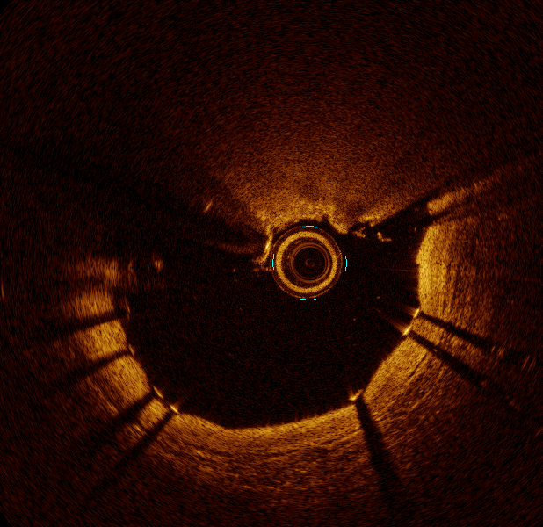
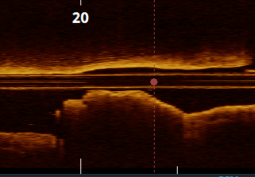
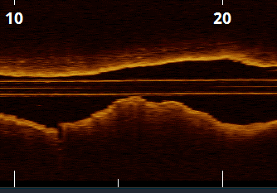
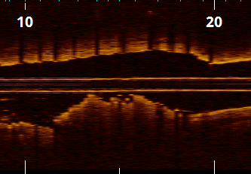
Non-Deformed Protruding Nodule
Pre-IVL
Post-IVL
Post-Stent
C
C’
C’’
23%

Slide 13
Non-Deformed Protruding Nodule

Slide 14
OCT Results
Core lab assessment | Patients without CN N=126 | Patients with CN N=29 | P value
Pre-procedure
MLA, mm² | 1.93 ± 0.79 | 2.07 ± 0.92 | 0.62
Area stenosis | 72.1 ± 11.59 | 74.3 ± 10.0 | 0.37
Maximum Ca angle | 272.1 ± 80.0 | 299.4 ± 74.0 | 0.07
Maximum Ca thickness | 0.96 ± 0.26 | 1.00 ± 0.25 | 0.43

Slide 15
IVL in CN Lesions
Consistent stent expansion and MSA following IVL treatment previously demonstrated in lesions with CN
However, the long-term clinical impact of these acute findings has not been reported
P = 0.12
P = 0.87
P = 0.91
P = 0.41
Ali et al. (2023) Safety and Effectiveness of Coronary Intravascular Lithotripsy for Treatment of Calcified Nodules: A Pooled Analysis from the Disrupt CAD studies. JACC Int. In press.

Slide 16
Target Lesion Failure
Core lab assessment | Overall CN N=29 | Eruptive CN N=14 | Non Eruptive CN N=15
Deformed CN (Post) | 21/26 (80.8) | 13/13 (100.0) | 8/13 (61.5)
TLF | 4 (13.9) | 2 (14.3) | 2 (13.3)
CD | 0 | 0 | 0
TV-MI | 4 | 2 | 2
ID-TLR | 2 | 1 | 1
Stent Thrombosis | 1 | 1 | 0

Slide 17
Target Lesion Failure
Log-rank p-value: 0.32
13.9%
8.0%
0
6
12
18
24
1
Months

Slide 18
2 Year Outcomes
p = 0.32
p = 0.24
p = 0.07
p = 0.21
p = 0.63
*N=1 ST event at POD 22

Slide 19
Conclusions
Consistent outcomes for stent expansion and MSA in lesions with and without CN following IVL treatment resulted in durable clinical outcomes to 2 years
TLF rate in the CN group was acceptable given the challenging calcified lesion subset, with only one stent thrombosis event in the entire cohort at 2 years
Larger studies to confirm these findings and additional analyses are needed to further elucidate the contributing factors to long-term clinical events in CN lesions treated with coronary IVL.

